Slide 1



BigHouse
by FrikiCode
We bring you…
THE APP THAT ALLOWS YOU TO CARE FOR YOUR LOVED ONES EVEN IF YOU’RE NOT THERE
Notes:
To view this presentation, first, turn up your volume and second, launch the self-running slide show.

Slide 2
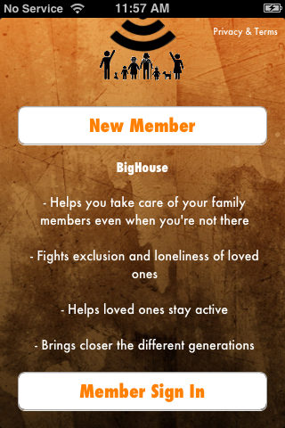

BigHouse App
OUR PURPOSE:
BigHouse
by FrikiCode
Notes:
To view this presentation, first, turn up your volume and second, launch the self-running slide show.

Slide 3
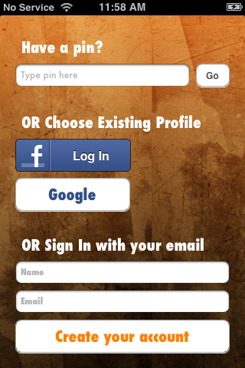
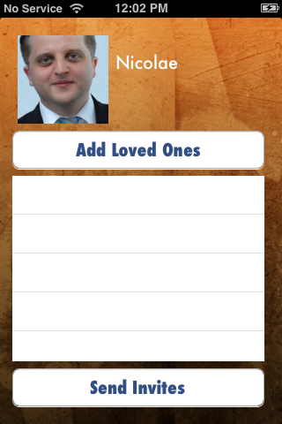
2 easy steps to start using the App…

Slide 4
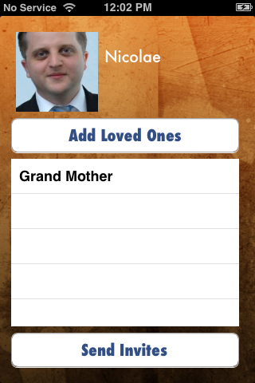
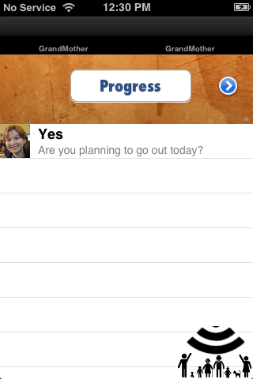
….and stay connected!

Slide 5
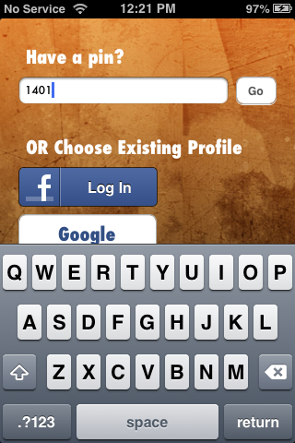
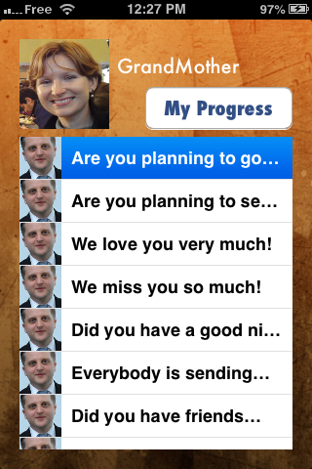
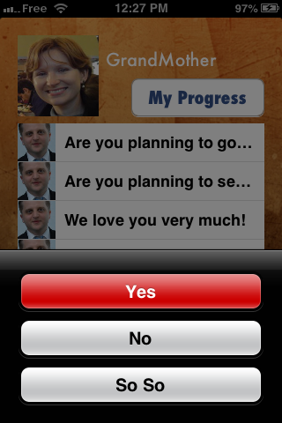
Easy and secure way for the loved ones
to connect and share with you

Slide 6
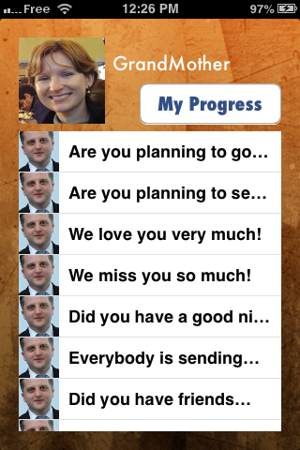
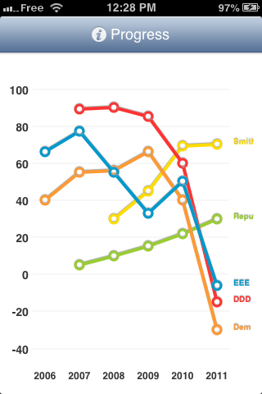
You can both monitor your loved ones’ general health, well being and activties

Slide 7





Have Fun !
Good Luck everyone!
BigHouse
by FrikiCode
Notes:
Presentations are a powerful communication medium.

